Slide 1
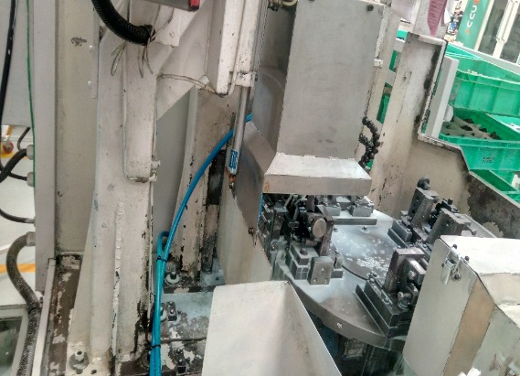
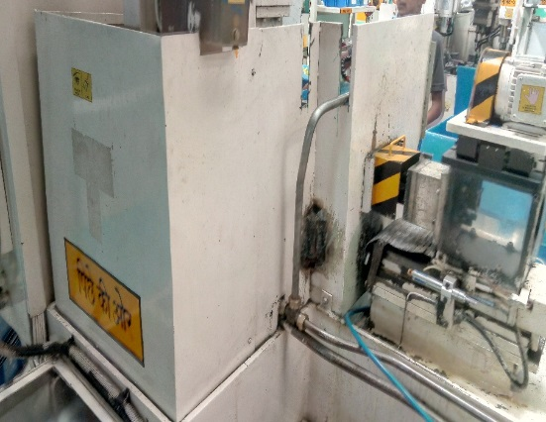
P15
TPM CIRCLE NO :- 01
ACTIVITY
KK
QM
PM
JH
SHE
OT
DM
E&T
KAIZEN IDEA SHEET
TPM CIRCLE NAME: Achiever
LOSS NO. / STEP
DEPT :- MACHINE SHOP
RESULT AREA
P
Q
A
B
C
D
S
M
CELL:- Bracket
CELL NAME:- A247 Bracket
MACHINE / STAGE :- SPM A1
OPERATION :- Drilling
KAIZEN THEME : To Reduced Jh time in spm A1.
IDEA : New localized guard with less height provided
PROBLEM PRESENT STATUS :- A247 BKT SPM A1 JH time Is 3 min /occurance
COUNTERMEASURE:-
New localized gurd provided
BENCHMARK
3 min
TARGET
1min
KAIZEN START
15.022017
TDC
24.04.2017
KAIZEN FINISH
24.04.2017
TEAM MEMBERS :.SC,DP,SK,SK,GG,SW
BENEFITS :-
1) Jh time reduction
Before
After
KAIZEN SUSTENANCE
WHY - WHY ANALYSIS :-
Why1 :- Why jh time is 3 min.
Why2 :- Difficult to clean index table back side Area
Why3 :- Not accessible easily to operator.
RESULT :-
WHAT TO DO:- Check point added in Sustenance audit check sheet
HOW TO DO:-. Check visually
FREQUENCY :- Daily
SCOPE & PLAN FOR HORIZONTAL DEPLOYMENT
Sr No | CELL | TDC | RESP. | STATUS
1 | B1 | 24/04/17 | SC | Completed
2
ROOT CAUSE : Gurd height more
REGISTRATION NO. & DATE : 15.02.2017
REGISTERED BY :- SANTOSH WAKCHAURE
MANAGER’S SIGN :- D Y PAWAR

